Slide 1
How Food & Drink Businesses can turn risk into savings
24th September 2026
Alistair Schuberth, Risk Partner, Marsh
Selena Kearvell, UK Food and Beverage Industry Leader, Marsh

Slide 2
Introducing Marsh
Providing Risk and Insurance solutions via our dedicated Food and Beverage Industry Practice
We work with 66% of the top 50 Food and Beverage companies
We work with 6 of the top 10 global alcoholic beverage manufacturers
We serve the top 3 frozen food manufacturers in UK
GBP 2Bn in food & beverage client premium placed globally
GBP 138M in food & beverage client premium placed in the UK
We serve four of the largest UK brewers
We serve 6 of the top 10 whisky companies

Slide 3
Agenda
Insurance and Risk Landscape -SK
Actionable steps you can take to reduce cost of risk AS
Summary of Key Take-aways SK
Q&A

Slide 4
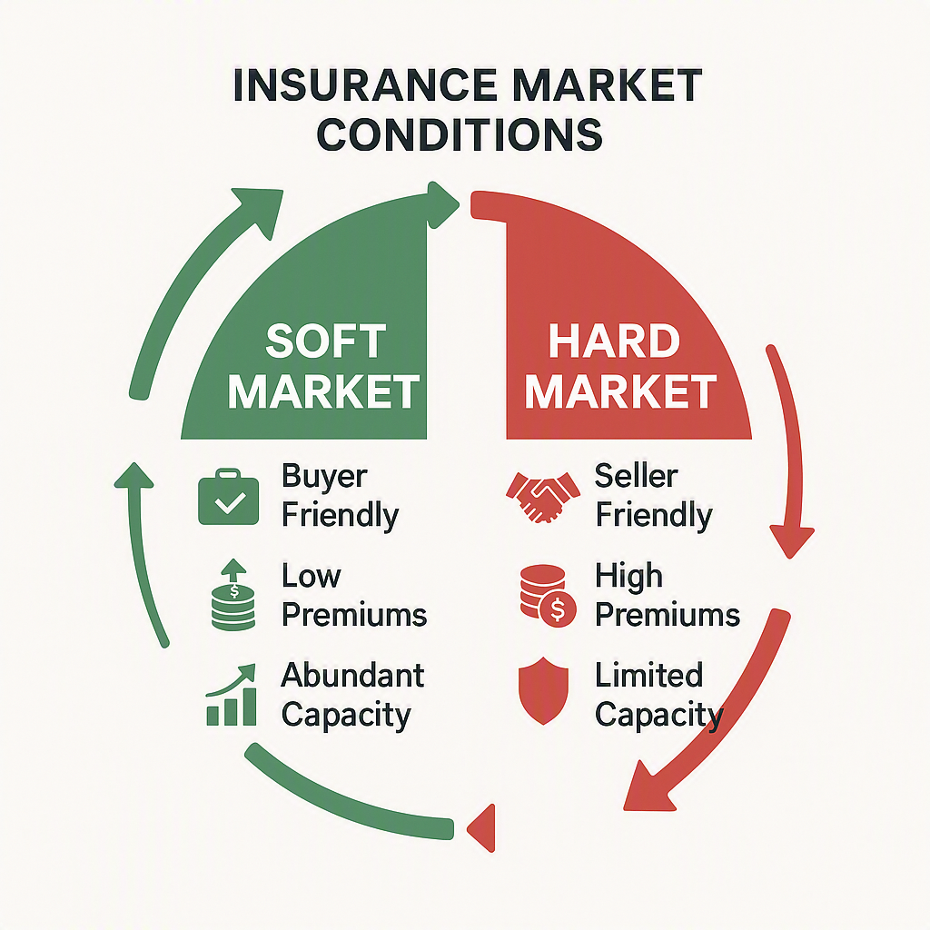
Soft Market vs Hard Market Cycle
SOFT MARKET
HARD MARKET
• Buyer-Friendly Terms
• Higher Premiums
• Abundant Capacity
• Limited Capacity
• Lower Premiums
• Seller-Friendly Terms
• Competitive Underwriting
• Stricter Underwriting
• Increased Coverage
• Limited Coverage
• Favorable Deductibles
• Higher Deductibles
UK Market: 2+ Years of Soft Conditions

Slide 5
Soft Market Opportunity for F&B Companies
Q2 2026: -8% Average Rate Reductions
Risk Bursaries
Low Claim Rebates
Value sharing arrangements that benefit both insurers and clients
Reward good claims experience with low-loss rebate programs
Long-Term Agreements
Cancel & Re-writes
Multi-year commitments unlock deeper discounts and stability
Revisit existing deals with incumbent markets mid-term
Key Insight: Strong market positioning and early negotiation during soft markets can yield substantial savings and improved terms

Slide 6
Securing Long-Term Advantage
Beyond Current Savings: Building Resilience for Market Shifts
The Reality
The Opportunity
• Soft markets are cyclical; they will eventually harden
• Invest in risk management NOW while insurers are engaged
• Current discounts won't persist
• Improve loss history and risk profile during soft market
• When markets harden, renewal terms tighten significantly – both cost and coverage
• Demonstrate continuous improvement to markets
• Historical performance becomes critical i.e. claims performance
• Position favorably for hard market renewals
Key Principle: The best time to invest in risk management is during a soft market when resources are available and insurers have incentive to support improvements.
Notes:
Current predictions are that the soft market could remain until 2028 – at this point the market may feel enough pain to create an inflection point.

Slide 7
Actionable Steps to reduce cost of Risk
01

Slide 8

Property Risk Protection
Achieving risk management best practice
Risk | Control
Hot processes e.g. ovens, fryers etc. | Clear oven shut down procedures Automatic suppression such as water misting Regular, documented (including photographs) cleaning and maintenance including ducts Periodicity to be determined through wet film thickness testing and compliance with TR19 guidance issued by the Building Engineering Services Association.
Composite panels used in wall and roof construction | Good records/knowledge of panel type Panel inspection systems Penetrations logging and fire stopping Use of Rockwool over combustible alternatives
Hot works | Robust hot works controls with complete and accurate documentary support
Automatic detection and suppression | Automatic detection in line with recognized national or international standard for property protection, i.e. BS5389: Part 1: Type P1, Detection and suppression activation tied to automatic shut off for machinery as well as gas supply Full premises sprinklers always preferred with reference to NFPA 13 – regarding design and install Two, 100% duty, fire pumps designed and installed in line with NFPA 20 A private water source designed and installed in accordance with NFPA 22 Documented inspections for systems for signs of corrosion, regular testing of sprinkler pumps
Construction | 2 hour firewalls to aid with premises segregation e.g. between warehousing and storage areas, production and access corridors etc.

Slide 9
Property Risk Protection
Achieving risk management best practice
Risk | Control
Lithium Ion Risks | Awareness of where these are present on site within work equipment e.g. MHE, PDA’s, transport equipment, and personal devices such as mobile phones, e-scooters, and e-bikes. Appropriate lockers for charging and storage of portable devices
Photovoltaic Panels | Avoid installation on combustible roofs Documented panel inspection regime to detect damage and vermin fouling
Dangerous Substances and Explosive Atmospheres Regulations (DSEAR) | Robust and through assessment where substances such as flour, sugar etc. processed.
Housekeeping | Avoid storage of combustible materials in internal and external areas where these are within 10m of premises walls if possible. General standards of housekeeping, spillages, leaks, walkway obstructions, external yard storage and vegetation
Electrical fire | Thermographic testing of electrical panels and distribution boards

Slide 10

People Risk Protection
Achieving risk management best practice
Risk | Control
Training | Recognised standards such as IOSH and NEBSOH beneficial amongst team leaders and H&S team Clarity around communication and understanding e.g. multilingual digital training packages with testing
Culture | Behaviours must mirror safe working procedures. E.g. climbing on machinery, manually free stoppages, bypassing guarding and lock outs Practice versus policy often a major sticking point. “Tolerated breaches” Adherence to PPE such as noise protection, respirators, and eye protection
Investigations | Detailed investigation and evidence gathering to ascertain facts around incidents Gaps such as lack of photographic evidence, training records, risk assessment, often lead to settlement
Housekeeping | Maintenance of equipment, particularly aged chillers, fridges and freezers etc. Spill kit availability Regular, documented cleaning regime. Clean as you go may hard to evidence
Operational Pressures | Focus on psychosocial wellbeing as a function of operator error and distraction as well as wider employee care. HSE focus on stress and mental health. Guarding on belts and rotating machinery, protection around auto packing machinery Work place transport in internal and external areas, adherence to walkways and pedestrian segregation arrangements
Industrial disease | Occupational health screening focussing on issues such as noise, lung function, and dermatological harms

Slide 11

Cyber Risk Protection
Achieving risk management best practice
Risk | Control
Detection and response | Monitoring for abnormal behaviour on production networks Incident response playbooks that include safe shutdown and recovery steps
Data Integrity and Reliability | Backups for recipes, parameters, and historic data, tested for restore Access control and logging for changes to set points, programmes, and quality data
Operational technology security | Monitoring for abnormal behaviour on production networks Incident response playbooks that include safe shutdown and recovery steps
Key Risk Areas | Staff awareness and training (90% of breaches due to human element) AI tools changing threat landscape, risk created through improper internal and external use Cyber Insurance Provides interruption cover to mitigate loss of revenue External tech and recovery support Negotiating teams for dealing with third parties Legal support for communicating with regulators Various costs of returning to pre incident state such as hardware replacement Key customer cover NB it may be one of your suppliers or customers that is impacted, not you.

Slide 12

Product Recall
Achieving risk management best practice
Risk | Control
Increased likelihood of recall | Strong understanding of the key product / quality risks you are exposed to Robust quality management and auditing systems Allergen management
Product design and compliance | Regulatory mapping and documented compliance testing before launch Risk assessment for safety-critical components and failure modes Clear allergen controls and awareness (links to training and client communication) Clear packaging controls, these can be compromised during crisis response or changes in supplier. Issues include suitability, integrity, and labelling
Quality and traceability | Batch and serial traceability across production, warehousing, and distribution (links to Cyber) Retention samples and clear acceptance criteria for critical characteristics Risks arise if suppliers need to be changed under duress/pressure
Recall readiness | Recall plan, including decision thresholds, communications, and regulator engagement Supplier due diligence and escalation routes for field issues Regime for testing responses to product recall incidents, links to Crisis Response and Business Continuity Planning

Slide 13
Summary
Making the most of a soft market
Capitalise on the soft market right now; bursaries, low claim rebates and rate reductions; consider long term rate stability agreements.
Consider your Property and People risk; how can you invest now to help ensure you get the best deals when the market hardens?
Consider your Cyber and Product recall risk; if you haven’t transferred to insurance now might be a good time to purchase these covers.

Slide 14
Q&A

Slide 15
Registered in England and Wales Number: 1507274, Registered Office: 1 Tower Place West, Tower Place, London EC3R 5BU. Marsh Ltd is authorised and regulated by the Financial Conduct Authority for General Insurance Distribution and Credit Broking (Firm Reference No. 307511).

